Slide 1
WAVESOFHOPEBOATING.ORG
Notes:
Waves of Hope is a coalition of families and friends working to prevent boating and water tragedies.
Up next is a short video about who we are.

Slide 2
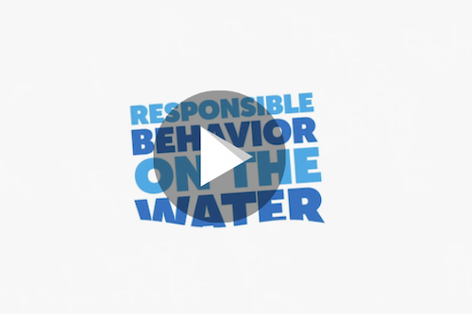
Notes:
Play Video
https://vimeo.com/378866987

Slide 3
Waves of Hope
A coalition of families and friends
working to prevent
boating and water tragedies.
WAVESOFHOPEBOATING.ORG
Notes:
Waves of Hope is an initiative from the National Safe Boating Council, a national catalyst for recreational boating safety, and the U.S. Coast Guard, produced under a grant from the Sport Fish Restoration and Boating Trust Fund.
Waves of Hope provides a platform for survivors and families that have lost loved ones or those that experienced a boating or water accident/injury to take action, share their story, and educate others on the importance of responsible boating in hopes to prevent future tragedies.

Slide 4
The Why
Platform for survivors and families:
Take action
Share their stories
Educate others
WAVESOFHOPEBOATING.ORG
Notes:
Waves of Hope provides a platform for survivors and families that have lost loved ones or those that experienced a boating or water accident/injury to take action, share their story, and educate others on the importance of responsible boating in hopes to prevent future tragedies.

Slide 5
Our Stories
NEVER THOUGHT
IT COULD
HAPPEN TO US
Notes:
Each family believed that drowning was something that happened to other people.
Then suddenly, without warning, we became “other people.”
It happens every day. To good families. To protective families. To normal families. Families like ours. Families like yours.

Slide 6
Our Stories
JUST ONE
MOMENT
Notes:
That one moment that changed our families forever could have been prevented. A life jacket. A propeller guard. An aware boat operator. An engine cut-off device. Learn from these stories and stay safe on the water.

Slide 7
Our Stories
NEVER THOUGHT
IT COULD
HAPPEN TO US
Notes:
Each family believed that drowning was something that happened to other people.
Then suddenly, without warning, we became “other people.”
It happens every day. To good families. To protective families. To normal families. Families like ours. Families like yours.

Slide 8
Our Stories
ARE
SAVING
LIVES
Notes:
That one moment that changed our families forever could have been prevented. A life jacket. A propeller guard. An aware boat operator. An engine cut-off device. Learn from these stories and stay safe on the water.
BY SHARING OUR STORIES WE ARE SAVING LIVES.

Slide 9
My Story
Customize this slide with loved one’s photo – Share information from the front of your story card
WAVESOFHOPEBOATING.ORG
Notes:
Share your loved one’s story

Slide 10
My Story
Customize this slide with your organization’s logo or another photo – Share information from the back of your story card
WAVESOFHOPEBOATING.ORG
Notes:
Share what you are doing to save lives on the water.

Slide 11
WAVESOFHOPEBOATING.ORG
Notes:
Waves of Hope provides a platform for survivors and families that have lost loved ones or those that experienced a boating or water accident/injury to take action, share their story, and educate others on the importance of responsible boating in hopes to prevent future tragedies.

Slide 12
WAVESOFHOPEBOATING.ORG
Notes:
Waves of Hope provides a platform for survivors and families that have lost loved ones or those that experienced a boating or water accident/injury to take action, share their story, and educate others on the importance of responsible boating in hopes to prevent future tragedies.

Slide 13
WAVESOFHOPEBOATING.ORG
Notes:
Waves of Hope provides a platform for survivors and families that have lost loved ones or those that experienced a boating or water accident/injury to take action, share their story, and educate others on the importance of responsible boating in hopes to prevent future tragedies.

Slide 14
What You Can Do
Take a boating safety course
Wear a life jacket
Assign a water watcher
Use an engine cut-off switch
Be responsible
Be educated
WAVESOFHOPEBOATING.ORG
Notes:
Just one moment can change your life.
Here’s what you can do.

Slide 15
LEARN MORE
WAVESOFHOPEBOATING.ORG

